Slide 1
ECE/CS 584: Hybrid Automaton Modeling Framework
Executions, Reach set, Invariance
Lecture 03
Sayan Mitra

Slide 2
Announcements
Project proposals due in a week
  2 pages with goals, description & milestones
Allerton Conference special session on Verification of CPS
  October 4th, 1:30 pm at Allerton House
  Free!

Slide 3
Plan for Today
Examples of hybrid models
Executions, reach sets, invariants

Slide 4
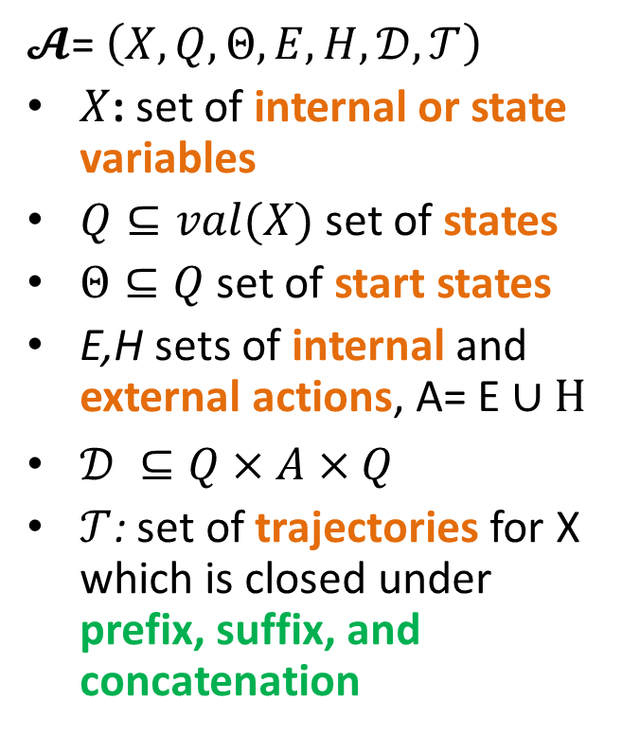
Hybrid Automata (a.k.a Timed Automata Kaynar, et al. 2005)
$𝓐$= $\left(X,Q,Θ,E,H,𝒟,𝒯\right)$
$X$: set of internal or state variables
$Q⊆val(X)$ set of states
$Θ⊆Q$ set of start states
E,H sets of internal and external actions, A= E ∪ H
$𝒟 ⊆Q×A×Q$
$𝒯$: set of trajectories for X which is closed under prefix, suffix, and concatenation
Notes:
Pick a couple of nice examples

Slide 5
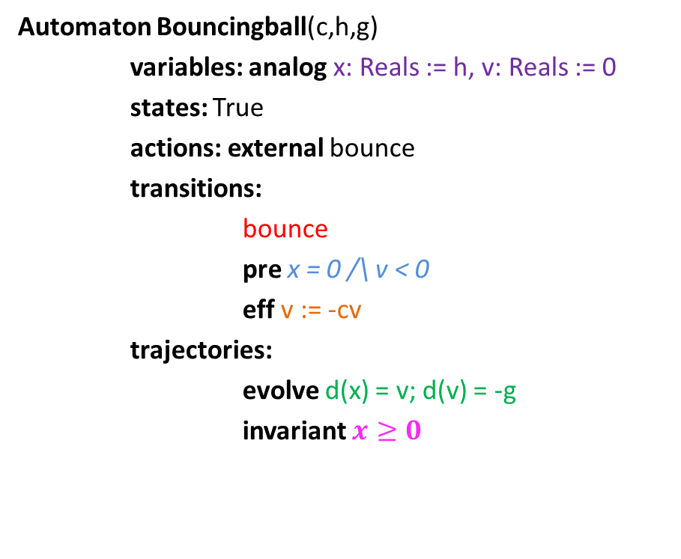
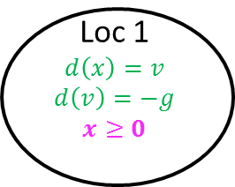
Bouncing Ball
bounce
x = 0 /\ v < 0
v’ := -cv
Automaton Bouncingball(c,h,g)
variables: analog x: Reals := h, v: Reals := 0
states: True
actions: external bounce
transitions:
bounce
pre x = 0 /\ v < 0
eff v := -cv
trajectories:
evolve d(x) = v; d(v) = -g
invariant $x≥0$
Loc 1
$$d\left(x\right)=v$$
$$d\left(v\right)=−g$$
$$x≥0$$
x:= h
Graphical Representation used in many articles
TIOA Specification Language
(close to PHAVer & UPPAAL’s language)
Notes:
Guard, Precondition
Effect, Reset map
Invariance

Slide 6
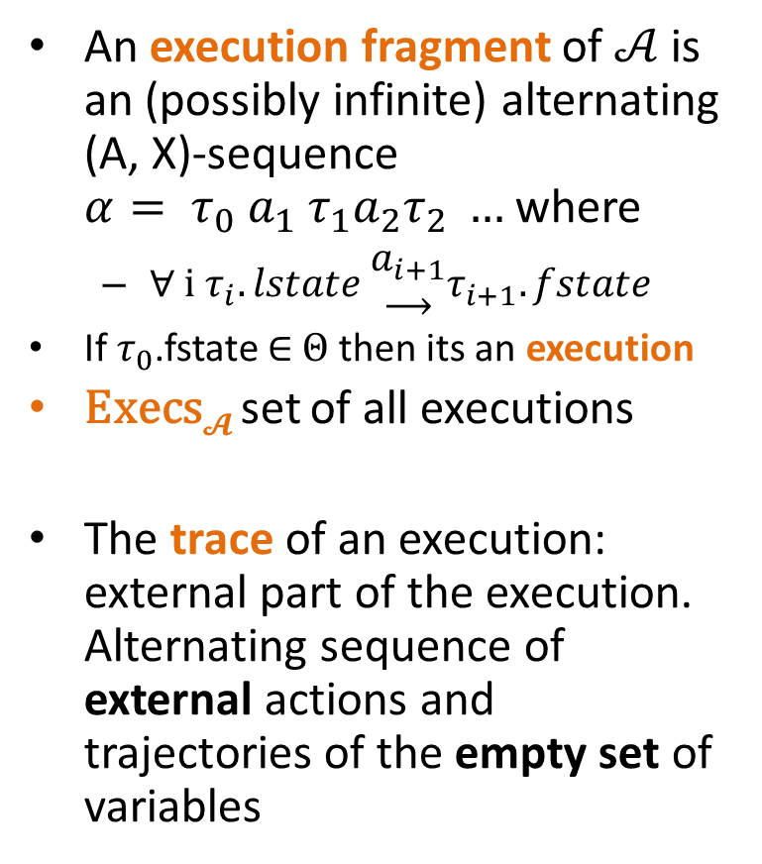
Semantics: Executions and Traces
An execution fragment of $𝒜$ is an (possibly infinite) alternating (A, X)-sequence $α= τ_{0} a_{1} τ_{1}a_{2}τ_{2} …$ where
  ∀ i $τ_{i}.lstate \begin{matrix}a_{i+1} \\ ⟶\end{matrix}τ_{i+1}.fstate$
  If $τ_{0}$.fstate ∈ $Θ$ then its an execution
Execs$𝓐$ set of all executions
The trace of an execution: external part of the execution. Alternating sequence of external actions and trajectories of the empty set of variables

Slide 7
Special kinds of executions
Infinite: Infinite sequence of transitions and trajectories
Closed: Finite with final trajectory with closed domain
Admissable: Infinite duration
  May or may not be infinite
Zeno: Infinite but not admissable
  Infinite number of transitions in finite time

Slide 8
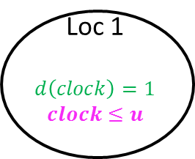
Periodically Sending Process
send(m:M)
clock = u
clock := 0
Automaton PeriodicSend(u, M)
variables: analog clock: Reals := 0
states: True
actions: external send(m:M)
transitions:
send(m)
pre clock = u
eff clock := 0
trajectories:
evolve d(clock) = 1
stop when clock=u
Loc 1
$$d\left(clock\right)=1$$
$$clock≤u$$
clock:= 0
Graphical Representation used in many articles
TIOA Specification Language
(close to PHAVer & UPPAAL’s language)

Slide 9
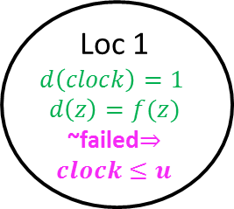
Another Example: Periodically Sending Process
Automaton PeriodicSend(u)
variables: analog
clock: Reals := 0, z:Reals, failed:Boolean := F
actions: external send(m:Reals), fail
transitions:
send(m)
pre clock = u /\ m = z /\ ~failed
eff clock := 0
fail
pre true
eff failed := T
trajectories:
evolve d(clock) = 1, d(z) = f(z)
stop when ~failed /\ clock=u
send(m)
clock = u /\ m = z /\ ~failed
clock := 0
Loc 1
$$d\left(clock\right)=1$$
$$d\left(z\right)=f(z)$$
~failed$⇒clock≤u$
clock:= 0
fail
true
failed := T

Slide 11
Modeling a Simple Failure Detector System
Periodic send
Channel
Timeout

Slide 12
Time bounded channel & Simple Failure Detector
Automaton Timeout(u,M)
variables: suspected: Boolean := F,
clock: Reals := 0
actions: external receive(m:M), timeout
transitions:
receive(m)
pre true
eff clock := 0; suspected := false;
timeout
pre ~suspected /\ clock = u
eff suspected := true
trajectories:
evolve d(clock) = 1
stop when clock = u /\ ~suspected
Automaton Channel(b,M)
variables: queue: Queue[M,Reals] := {}
clock: Reals := 0
actions: external send(m:M), receive(m:M)
transitions:
send(m)
pre true
eff queue := append(<m, clock+b>, queue)
receive(m)
pre head(queue)[1] = m
eff queue := queue.tail
trajectories:
evolve d(clock) = 1
stop when ∃ m, d, <m,d> ∈ queue
/\ clock=d

Slide 13

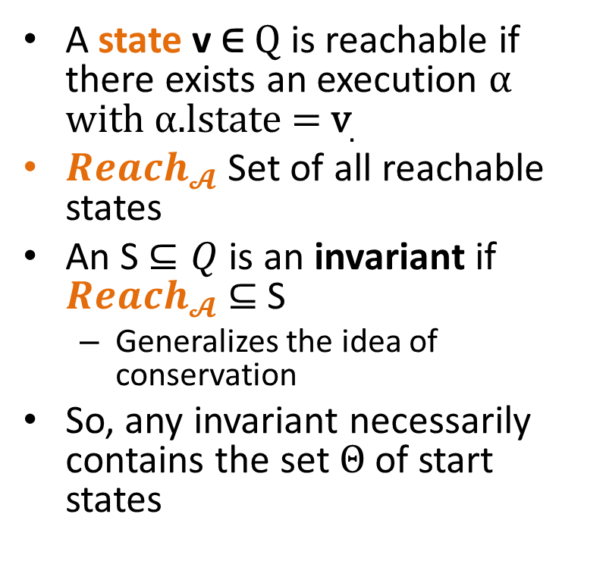
Reachable States and Invariants
A state v ∈ Q is reachable if there exists an execution α with α.lstate = v.
${Reach}_{𝓐}$ Set of all reachable states
An S $⊆Q$ is an invariant if ${Reach}_{𝓐}$ $⊆$ S
  Generalizes the idea of conservation
So, any invariant necessarily contains the set $Θ$ of start states
Examples:
  Bouncing ball: h ≥ x ≥0
  0 < v² ≤ 2g(h-x)
  Periodic send: ~failed $⇒clock ≤u$

Slide 14
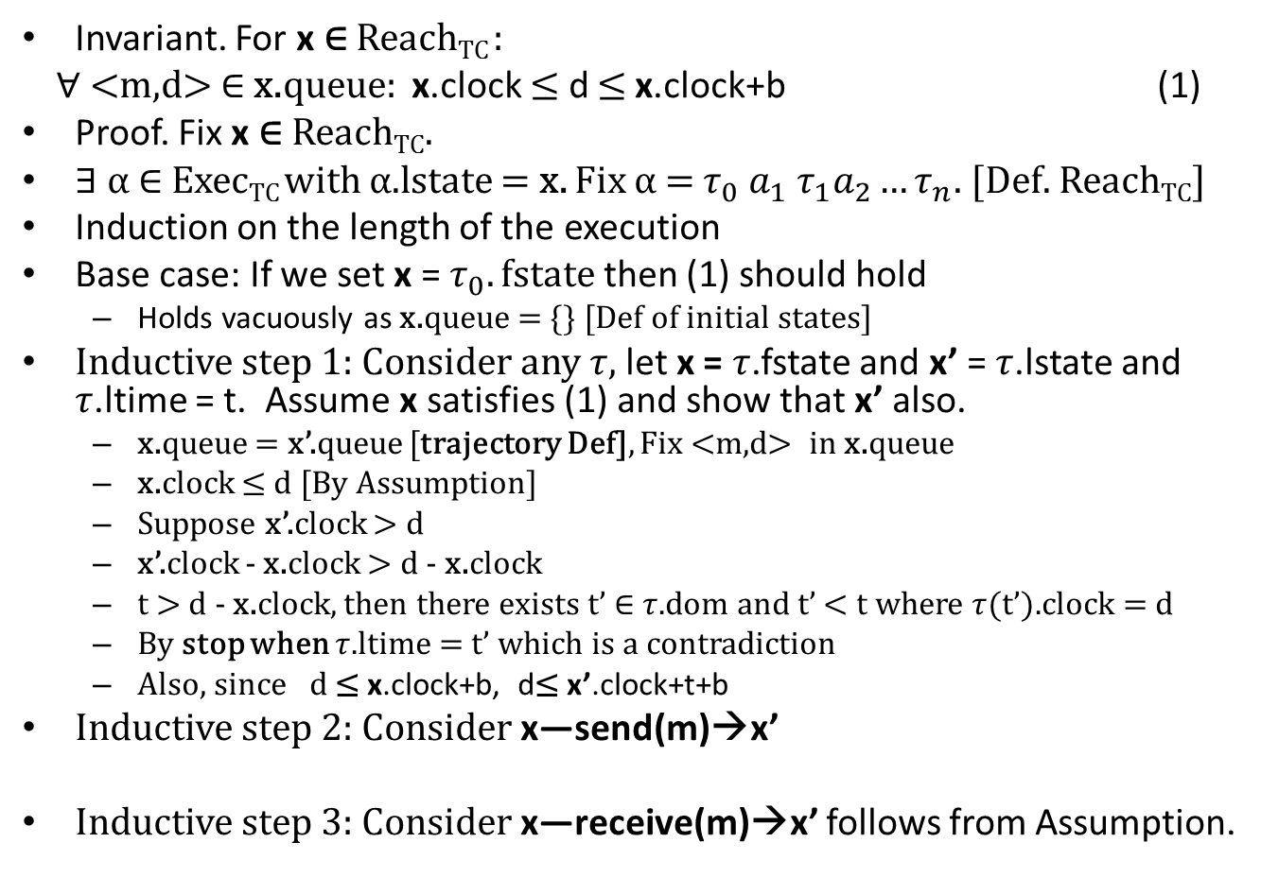
Example Inductive Invariance Proof
Invariant. For x ∈ Reach_{TC} :
∀ <m,d> ∈ x.queue: x.clock $≤$ d $≤$x.clock+b (1)
Proof. Fix x ∈ Reach_{TC}.
∃ α ∈ Exec_{TC} with α.lstate = x. Fix α = $τ_{0} a_{1} τ_{1}a_{2}…τ_{n}$. [Def. Reach_{TC}]
Induction on the length of the execution
Base case: If we set x = $τ_{0}.fstate$ then (1) should hold
  Holds vacuously as x.queue = {} [Def of initial states]
Inductive step 1: Consider any $τ,$let x = $τ$.fstate and x’ = $τ$.lstate and $τ$.ltime = t. Assume x satisfies (1) and show that x’ also.
  x.queue = x’.queue [trajectory Def], Fix <m,d> in x.queue
  x.clock ≤ d [By Assumption]
  Suppose x’.clock > d
  x’.clock - x.clock > d - x.clock
  t > d - x.clock, then there exists t’ ∈ $τ$.dom and t’ < t where $τ$(t’).clock = d
  By stop when $τ$.ltime = t’ which is a contradiction
  Also, since d ≤ x.clock+b, d≤ x’.clock+t+b
Inductive step 2: Consider x—send(m)→x’
Inductive step 3: Consider x—receive(m)→x’ follows from Assumption.

Slide 15
Summary & Roadmap
Hybrid Automata
Syntax
Executions
Reach sets, Invariance
Abstractions, Simulations and Composition

