Slide 1
ECE/CS 584: Verification of Embedded Computing Systems Timed to Hybrid Automata
Sayan Mitra (edited by Yu Wang)
Lecture 10

Slide 2
Announcements
HW2 released
start soon
Readings
[Henz95] Thomas Henzinger, Peter Kopke, Anuj Puri, and Pravin Varaiya. What's Decidable About Hybrid Automata?. Journal of Computer and System Sciences, pages 373–382. ACM Press, 1995.

Slide 3
Last lecture
Focus on specific classes of Hybrid Automata for which safety properties (invariants) can be verified completely automatically
Alur-Dill’s Integral Timed Automata (ITA)
Control State Reachability (CSR) problem
Construction of Region Automaton (FSM)
Today
How far can we generalize ITAs while preserving decidability of CSR

Slide 4
Clocks and Rational Clock Constraints
A clock variable x is a continuous (analog) variable of type real such that along any trajectory $τ$ of x, for all t $∈τ.dom, \left(τ↓x\right)\left(t\right)=t$.
For a set X of clock variables, the set $Φ$(X) of integral clock constraints are expressions defined by the syntax:
g ::= x $≤q \left| x≥q \right| ¬ g | g_{1}∧ g_{2}$
where $x∈X and q∈ ℚ$
Examples: x = 10.125; x $∈$ [2.99, 5); true are valid rational clock constraints
Semantics of clock constraints $[g]$

Slide 5
Step 1. Rational Timed Automata
Definition. A rational timed automaton is a HIOA A = $〈V, Q, Θ, A, 𝒟, 𝒯〉$ where
V = X $∪\left\{loc\right\}$, where $X$ is a set of n clocks and $l$ is a discrete state variable of finite type Ł
A is a finite set
$𝒟$is a set of transitions such that
The guards are described by rational clock constraings $Φ(X)$
$〈x,l〉−a→〈x^{′},l^{′}〉$ implies either $x^{′}=x$ or $x=0$
$𝒯$ set of clock trajectories for the clock variables in X

Slide 6
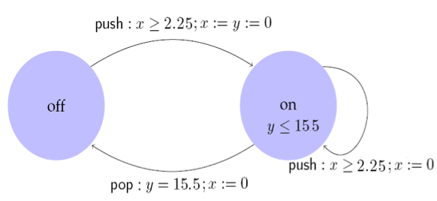
Example: Rational Light switch
Switch can be turned on whenever at least 2.25 time units have elapsed since the last turn off. Switches off automatically 15.5 time units after the last on.
automaton Switch
internal push; pop
variables
internal x, y:Real := 0, loc:{on,off} := off
transitions
internal push
pre x >=2.25
eff if loc = on then y := 0 fi; x := 0; loc := off
internal pop
pre y = 15.5 $∧$ loc = off
eff x := 0
trajectories
invariant loc = on $∨$ loc = off
stop when y = 15.5 $∧$ loc = off
evolve d(x) = 1; d(y) = 1

Slide 7
Control State (Location) Reachability Problem
Given an RTA, check if a particular location is reachable from the initial states
Is problem decidable? Yes
Key idea:
Construct a ITA that is bisimilar to the given RTA
Check CSR for ITA

Slide 8
Construction of ITA from RTA
Multiply all rational constants by a factor q that make them integral
Make d(x) = q for all the clocks
RTA Switch is bisimilar to ITA Iswitch
Simulation relation R is given by (u,s) $∈R$iff u.x = 4 s.x and u.y = 4 s.y
automaton ISwitch
internal push; pop
variables
internal x, y:Real := 0, loc:{on,off} := off
transitions
internal push
pre x 9
eff if loc = on then y := 0 fi; x := 0; loc := off
internal pop
pre y = 62 $∧$ loc = off
eff x := 0
trajectories
invariant loc = on $∨$ loc = off
stop when y = 62 $∧$ loc = off
evolve d(x) = 4; d(y) = 4

Slide 9
Step 2. Multi-Rate Automaton
Definition. A multirate automaton is a HIOA A = $〈V, Q, Θ, A, 𝒟, 𝒯〉$ where
V = X $∪\left\{loc\right\}$, where $X$ is a set of n continuous variables and $loc$ is a discrete state variable of finite type Ł
A is a finite set
$𝒟$is a set of transitions such that
The guards are described by rational clock constraings $Φ(X)$
$〈x,l〉−a→〈x^{′},l^{′}〉$ implies either $x^{′}=c$
$𝒯$ set of trajectories such that for each $x∈ X ∃k such that τ∈𝒯, t∈τ.dom$
$$τ\left(t\right).x=τ\left(0\right).x+k t$$

Slide 10
Control State (Location) Reachability Problem
Given an MRA, check if a particular location is reachable from the initial states
Is problem is decidable? Yes
Key idea:
Construct a RTA that is bisimilar to the given MRA

Slide 11
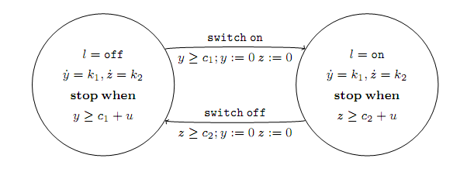
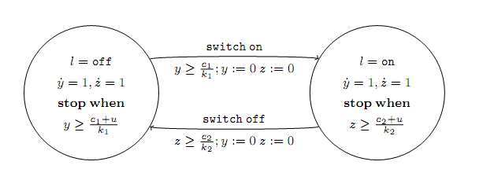
Example

Slide 12
Step 3. Initialized Rectangular HA
Definition. An initialized rectangular hybrid automaton (IRHA) is a HIOA A = where
V = X , where is a set of n continuous variables and is a discrete state variable of finite type Ł
A is a finite set
is a set of transitions such that
The guards are described by rational clock constraings
implies
If the dynamics of changes from to ’ then
Otherwise
set of trajectories such that for each
That is, for any

Slide 14
Split every variable into two automaton.
Example
In prev. automaton:
x' \in [a_1,b_1]
In new automaton:
x'_v = a_1; x'_u = b1
guard:
x \geq 5 --> x_l \geq 5
reset:
x := 4 --> x_l, x_u := 4

Slide 15
CSR Decidable for IRHA?
Given an IRHA, check if a particular location is reachable from the initial states
Is problem is decidable? Yes
Key idea:
Construct a 2n-dimensional initialized Singular automaton (Multi-rate automaton) that is bisimilar to the given IRHA
Construct a ITA that is bisimilar to the Singular TA

Slide 16
Example IRHA
$$c≔0;d≔1$$
v1
$$\dot{c}∈\left[1,3\right]$$
$$\dot{d}∈[−3,−2]$$
$c≥0∧d≤$2
$$d≔1$$
v4
$$\dot{c}∈\left[1,3\right]$$
$$\dot{d}∈[1,2]$$
$$c≤5∧d≤−3$$
$$c≔4$$
$c≥−3∧d≤−$2
$$c∈[−1,−2]$$
v2
$$\dot{c}∈\left[−4,−2\right]$$
$$\dot{d}∈[−3,−2]$$
$$d≤−5$$
$$d≔−4$$
v3
$$\dot{c}∈\left[−4,−2\right]$$
$$\dot{d}∈[1,2]$$

Slide 17
Initialized Singular HA
$$c_{l},c_{u}≔0;d_{l}, d_{u}≔1$$
v1
$$\dot{c_{l}}=1$$
$$\dot{c_{u}}=3$$
$$\dot{d_{l}}=−3$$
$$\dot{d_{u}}=−2$$
v4
$\dot{\begin{aligned}\dot{c_{l}}=1 \\ \dot{c_{u}}=3 \\ \begin{aligned} \dot{d_{l}}=1 \\ \dot{d_{u}}=2 \end{aligned}\end{aligned}}$
v2
$$\dot{\begin{aligned}\dot{c_{l}}=−4 \\ \dot{c_{u}}=−2 \\ \begin{aligned} \dot{d_{l}}=−3 \\ \dot{d_{u}}=−2 \end{aligned}\end{aligned}}$$
v3
$$\dot{\begin{aligned}\dot{c_{l}}=−4 \\ \dot{c_{u}}=−2 \\ \begin{aligned} \dot{d_{l}}=1 \\ \dot{d_{u}}=2 \end{aligned}\end{aligned}}$$

Slide 18
Transitions
v1
$$\dot{c_{l}}=1$$
$$\dot{c_{u}}=3$$
$$\dot{d_{l}}=−3$$
$$\dot{d_{u}}=−2$$
5
$$c_{u}$$
$$c_{l}$$
$$c_{l}≤5$$
$$c_{l}, c_{u}≔4$$
$d_{u}≤−3$ no reset
$d_{u}>−3∧d_{l}≤−3 d_{u}≔$-3
$${d_{u}}_{ }$$
-3
$$d_{l}$$

Slide 19
Initialized Singular HA
$$c_{l},c_{u}≔0;d_{l}, d_{u}≔1$$
v1
$$\dot{c_{l}}=1$$
$$\dot{c_{u}}=3$$
$$\dot{d_{l}}=−3$$
$$\dot{d_{u}}=−2$$
$c_{l}≥0∧d_{l}≤$2
$$d_{l}, d_{u}≔1$$
v4
$\dot{\begin{aligned}\dot{c_{l}}=1 \\ \dot{c_{u}}=3 \\ \begin{aligned} \dot{d_{l}}=1 \\ \dot{d_{u}}=2 \end{aligned}\end{aligned}}$
$c_{l}<0∧c_{u}≥0∧d_{l}≤$2
$$c_{l}≔0d_{l}, d_{u}≔1$$
$$c_{l}≤5∧d_{u}≤−3$$
$$c_{l}, c_{u}≔4$$
$$c_{l}≤5∧d_{l}≤−3∧d_{u}>−3$$
$$c_{l}, c_{u}≔4 d_{u}≔−3$$
$c_{u}≥−3∧d_{u}≤−$2
$$c_{l}≔−2c_{u}≔−1$$
$c_{u}≥−3∧d_{l}≤−2 ∧d_{u}>−2$
$$c_{l}≔−2c_{u}≔−1 d_{u}−2$$
v2
$$\dot{\begin{aligned}\dot{c_{l}}=−4 \\ \dot{c_{u}}=−2 \\ \begin{aligned} \dot{d_{l}}=−3 \\ \dot{d_{u}}=−2 \end{aligned}\end{aligned}}$$
$$d_{l}≤−5$$
$$d_{l}d_{u}≔−4$$
v3
$$\dot{\begin{aligned}\dot{c_{l}}=−4 \\ \dot{c_{u}}=−2 \\ \begin{aligned} \dot{d_{l}}=1 \\ \dot{d_{u}}=2 \end{aligned}\end{aligned}}$$

Slide 20
Can this be further generalized ?
For initialized Rectangular HA, control state reachability is decidable
Can we drop the initialization restriction?
No, problem becomes undecidable
Can we drop the rectangular restriction?
No, problem becomes undecidable
Tune in in a week

Slide 21
Reachability Computation with polyhedra
A set of states is represented by disjunction of linear inequalities
$\left(loc=l_{1}∧A_{1}x≤b_{1}\right)∨\left(loc=l_{2}∧A_{2}x≤b_{2}\right)∨…$
Post(,) computation performed symbolically using quantifier elimination
Portion of Navigation benchmark
$x^{′}=k→Post\left(\left[a_{1}, a_{2}\right]\right)=∃t \left[a_{1}+kt, a_{2}+kt\right]=[a_{1},∞]$
the state is reachable if there exists a time when we reach it.

Slide 22
Summary
ITA: (very) Restricted class of hybrid automata
Clocks, integer constraints
No clock comparison, linear
Control state reachability with Alur-Dill’s algorithm (region automaton construction)
Rational coefficients
Multirate Automata
Initialized Rectangular Hybrid Automata
HyTech, PHAVer use polyhedral reachability computations
Notes:
fix-point implementation in tools
We can remove the init. set. Hytech will accept the automaton, but there is no guarantee on termination

