Slide 1
HIGH LEVEL TASKS TO
LOW LEVEL CONTROLLERS
ECE584: Embedded System Verification
Lecture 21 slides from: Hadas Kress-Gazit hadaskg@grasp.upenn.edu lecturer : Sayan Mitra mitras@crhc.uiuc.edu

Slide 2
Synthesis Problem for Hybrid Systems
How does one describe symbolic, high level tasks and transform them automatically
into sensing and control while obtaining formal guarantees of correctness?

Slide 3
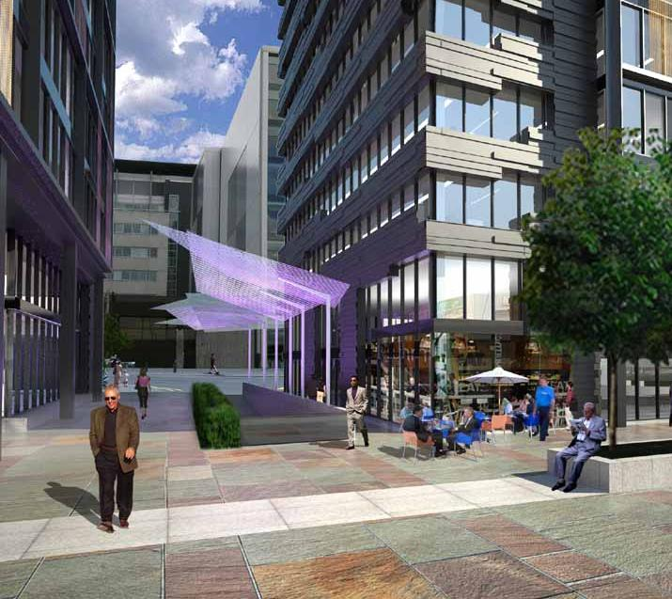
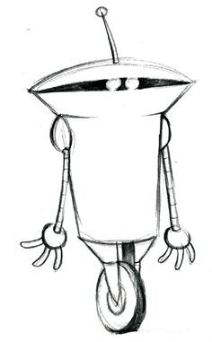


Problem
task
specification
?
dynamic environment
robot model
correct robot motion and action

Slide 4
previous work: planning in AI and control
Schoppers. Universal plans for reactive robots in unpredictable environments. IJCAI 1987.
LaValle. Planning Algorithms. Cambridge University Press, Cambridge, 2006
Burridge, Rizzi, and Koditschek, Sequential composition of dynamically dexterous robot behaviors, J. of Robotics Research, 1999.
Choset, Lynch, Hutchinson, Kantor, Burgard, Kavraki & Thrun. Principles of Robot Motion: Theory, Algorithms, and Implementations. MIT Press, Boston, 2005.
Frazzoli, Dahleh, & Feron, Maneuver-based motion planning for nonlinear systems with symmetries, IEEE Trans. Robot., 2005.

Slide 5
planning with hybrid systems
Kress-Gazit, Fainekos, Pappas: Where's Waldo? Sensor-Based Temporal Logic Motion Planning. ICRA 2007.
Quottrup, Bak and Izadi-Zamanabadi. “Multi-robot planning : a timed automata approach”. ICRA, 2004.
Kloetzer and Belta. “A fully automated framework for control of linear systems from LTL specifications”. HSCC, 2006.
Delmotte, Mehta, & Egerstedt, “Modebox a software tool for obtaining hybrid control strategies from data,” IEEE Robot. Automat. Mag., 2008.

Slide 6
outline
planning for static environments
planning for dynamic environments
complex dynamics
distributed robotics
case studies

Slide 7
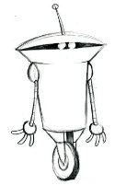
static environments
starting in corridor 12, go to Rooms 1, 7 and 2 in any order, then to Room 8 and finally, go to either Room 4 or 5 without going through corridor 12
8
7
1
9
12
10
6
2
11
3
4
5

Slide 8
static environments
robot model: we consider a fully actuated, planar model of robot motion
operating in a polygonal environment P. The motion of the robot is
expressed as:
specification: linear temporal logic (LTL) formula φ
problem: given robot model, environment P, initial condition p(0),
and an LTL formula φ, find control input u(t) such that p(t) satisfies φ.

Slide 9
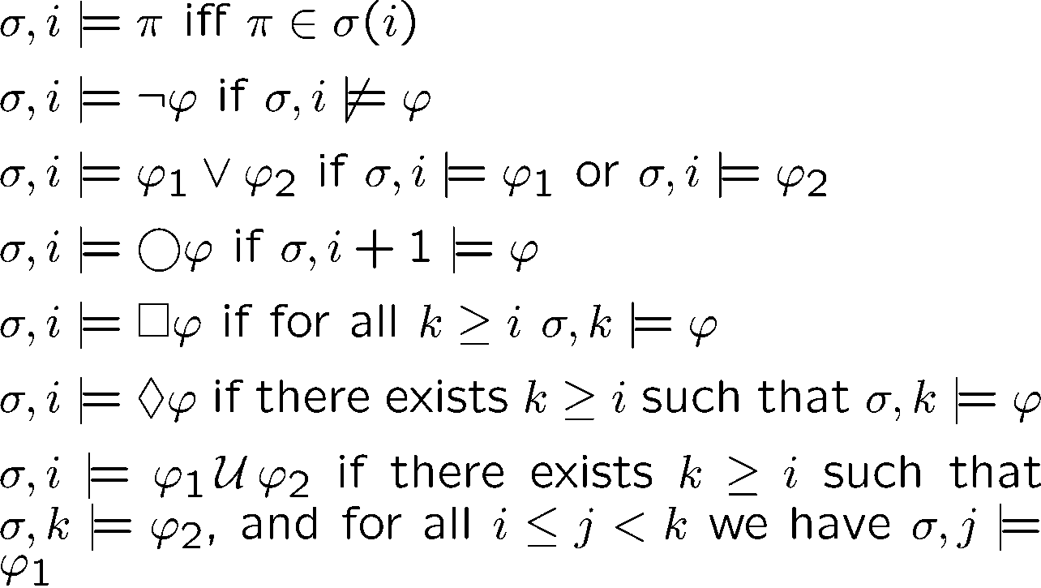
Linear Temporal Logic (LTL)
Syntax:
Semantics: Truth is evaluated along infinite computation paths σ ((a,b),a,a,a… (a,b),(a,b),(a,c),(a,c),…)
a,b
b,c
a
a,b
“next”
a,b
“always”
“eventually”
a,c
“until”

Slide 10
model checking
specification
φ
LTL
FSM S
a,b
b,c
a
a,b
a,b
a,c
does every path in S
satisfy φ ?
    Complexity of LTL model checking |S|2^{| φ |}
    guaranteed to terminate with the correct answer.
    if not satisfied, a counter-example path is given

Slide 11
task specifications in LTL
    “visit rooms 1,2,3 while avoiding corridor 1”:
    [] ¬(corridor1) ∧ ◊(room1) ∧ ◊(room2) ∧ ◊(room3)
    “ if the light is on, visit rooms 1 and 2 infinitely often”:
    []( (LightOn) -> ([]◊(room 1) ∧ []◊(room 2)) )
    “if you are in room 3 and Mika is there, beep”
    []( (room3) ∧ (SeeMika) -> (Beep) )
    and much more…

Slide 12
1
8
7
discrete
abstraction
9
2
12
10
6
11
atomic
propositions
robot model:
transition rules
3
4
5
workspace
LTL formula φ
high level
task
controller
correct robot motion

Slide 13

Using Model Checking
1
8
7
discrete
abstraction
9
2
12
10
6
11
atomic
propositions
3
4
5
robot
workspace
LTL formula φ
high level
task
find a counter example for ¬φ
Path
hybrid controller
correct robot motion and action
Notes:
a path does not satisfy not \phi implies it satisfies \phi
so this gives a plan for accomplishing \phi
abstract, discrete

Slide 14
Example
“Go to room 4”
φ = ◊(room4)
Model check the formula ¬φ
¬◊(room4)
The formula is False and the counter example is:
room1, room9, room12, room11, room4
Gives a path to room 4
8
7
8
1
1
7
9
9
2
12
10
6
2
12
10
6
11
11
3
4
5
3
5
4

Slide 15
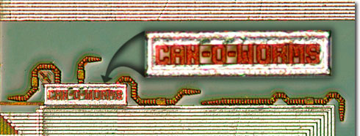
Synthesis
System/Program/Design
Requirements
    given a formula, create the system
    synthesis of the full LTL is double exponential in the size of the formula
    for a specific fragment, it is polynomial in the state space

Slide 16
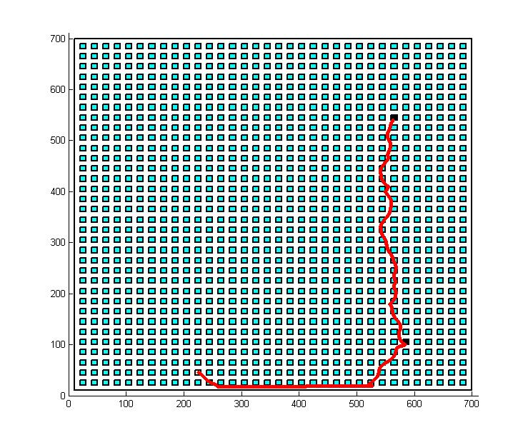
Advantages
  Can handle large problems – “Symbolic model checking: 10²⁰ states and beyond” (Burch, Clarke, McMillan,Dill,Hwang)
  Complex motion behaviors:
    “Go to X or Y while avoiding Z”
    “If you go through W then go to X too”
    “Go to X,Y,W and Z in any order”
  Many tools (NuSMV, SPIN…)
Disadvantages
  Paths are not optimal
  Result is a path – not a plan, so we can’t do reactive tasks.

Slide 17
From FSM to Hybrid controller
8
7
1
9
2
12
10
6
11
3
5
4
need continuous controllers to “match” the discrete transitions
design “atomic” feedback controllers to mimic the transitions
bisimilar by construction

Slide 18
Hybrid controller
We compose a set of “atomic” feedback controllers that drive the robot based on its dynamics.

Slide 19
Guarantee
Given a workspace decomposition and a set of atomic controllers, if the specification φ can be satisfied by the discrete abstraction, a hybrid controller will be generated such that p(t) satisfies φ

Slide 20
Reactive planning for dynamic environments

Slide 21

“Nemo may be sitting in one of rooms 1, 3, 5 and 8. Starting in corridor 12, look for him in these rooms. If at some point you see him, stop and beep”
8
7
1
9
12
10
6
2
11
3
4
5

Slide 22
Dynamic environments
Model: We consider a fully actuated, planar model of robot motion
operating in a polygonal environment P. The motion of the robot is
expressed as:
In addition, the robot has binary sensor inputs and actions
Specification: A linear temporal logic (LTL) formula φ that captures
assumptions about the environment and the robot’s reactive behavior.
Problem: Given robot model, environment P, set of initial conditions,
and an LTL formula φ, find control input u(t) such that p(t) satisfies φ,
in any admissible environment

Slide 23
Sensor
inputs
1
8
7
Discrete
Abstraction
9
Actions
10
6
2
12
11
Binary
Propositions
3
4
5
robot
Known workspace
Temporal logic formula φ
high level
task
Automaton
Hybrid Controller
Correct robot motion and action

Slide 24
Constructing φ
Sensor
inputs
1
8
7
Discrete
Abstraction
9
Actions
10
6
2
12
11
3
4
5
robot
Known workspace
Sensor (Input) propositions:
X = {SenseNemo, SenseFire, HearBaby,… }
= {s_{Nemo}}
Robot (Output) propositions:
Y = {Room1, Room2,…,Room12, Beep, RecordVideo,… }
= {r₁, r₂,…, r₁₂,Beep }

Slide 25

LTL fragment
We consider LTL formulas of the form:
Assumptions about
environment
Desired
robot behavior
only if the assumptions are met the desired behavior is guaranteed.

Slide 26
Example
Task: “Nemo may be sitting in one of rooms 1, 3, 5 and 8. Starting in corridor 12, look for him in these rooms. If at some point you see him, stop and beep”
Sensor (Input) propositions: X = {s_{Nemo}}
Robot (Output) propositions: Y = {r₁, r₂,…, r₁₂,Beep}
Environment Assumptions
Desired behavior
Initial Conditions
Transitions
Goals

Slide 27
Why this structure?
Can be synthesized into an automaton
No significant loss of expressivity with respect to the full LTL
Clear distinction between assumptions and desired behavior
Notes:
φ

Slide 28
Automaton and controller
synthesis algorithm due to Piterman, Pnueli and Sa’ar (VMCAI 2006)
polynomial O(n³) in the number of states (as opposed to double exponential in the length of the formula)
solves a game between the environment and the robot. If the robot wins, no matter what the environment does, an automaton is extracted.
hybrid controller activates the atomic controllers and binary actions based on the sensor inputs

Slide 29

Example
Task: “Nemo may be sitting in one of rooms 1, 3, 5 and 8. Starting in corridor 12, look for him in these rooms. If at some point you see him, stop and beep”
Beep
r₈
Beep
r₅
s_{Nemo}
s_{Nemo}
s_{Nemo}
r₁₀
r₉
r₈
r₅
r₉
r₁₂
s_{Nemo}
Beep
r₁
r₁₀
s_{Nemo}
r₁
s_{Nemo}
r₁₁
r₉
8
7
r₁₂
1
Beep
r₃
r₃
r₁₁
s_{Nemo}
s_{Nemo}
9
10
6
2
12
11
3
4
5

Slide 30
Guarantee
Given a workspace decomposition and a set of atomic controllers, if the specification can be satisfied by the discrete abstraction and the environment satisfies the assumptions made, a hybrid controller will be generated such that p(t) satisfies φ

Slide 31
When will this break?
Task ( )
φ is realizable
Automaton
Bisimilar controllers
Guaranteed
Environment
Hybrid controller

Slide 32
When will this break?
Task ( )
φ is realizable
Automaton
Bisimilar controllers
Environment
Hybrid controller

Slide 33
When will this break?
Task ( )
φ is realizable
Automaton
Bisimilar controllers
Environment
Hybrid controller

Slide 34
When will this break?
Logical inconsistency – “go to room 1 & always stay in 4”
Topologically impossible – “go to room 5 & always avoid room 10”
→ No automaton is synthesized
Environment behaves badly –
  Sensors inputs contradict assumptions ( is false)
  “Violent” environment
→ Execution may be incorrect or terminated prematurely

Slide 35
Incorporating
Complex dynamics

L
❑
(x, y)

Slide 36
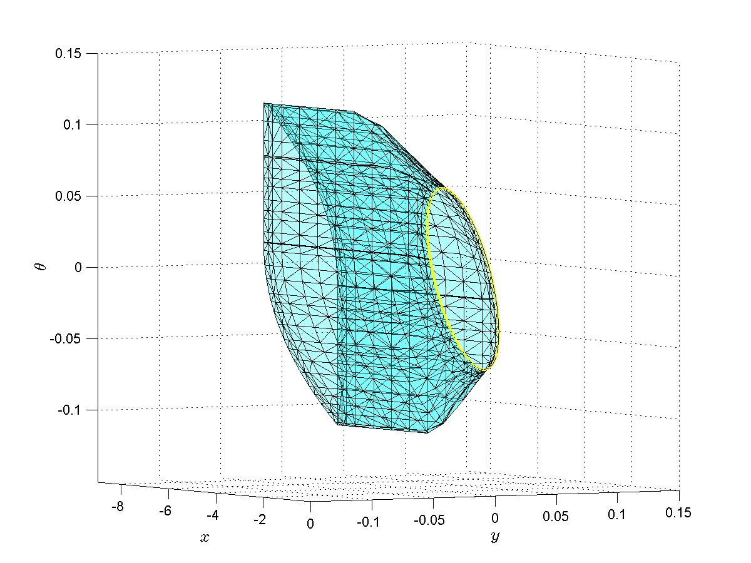
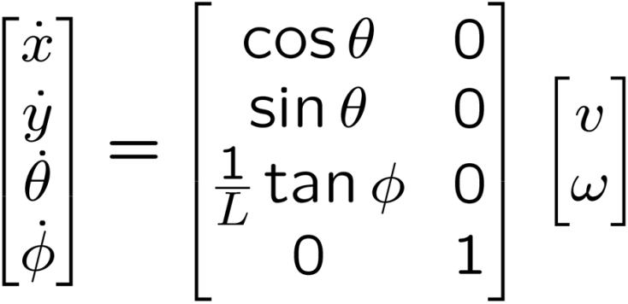
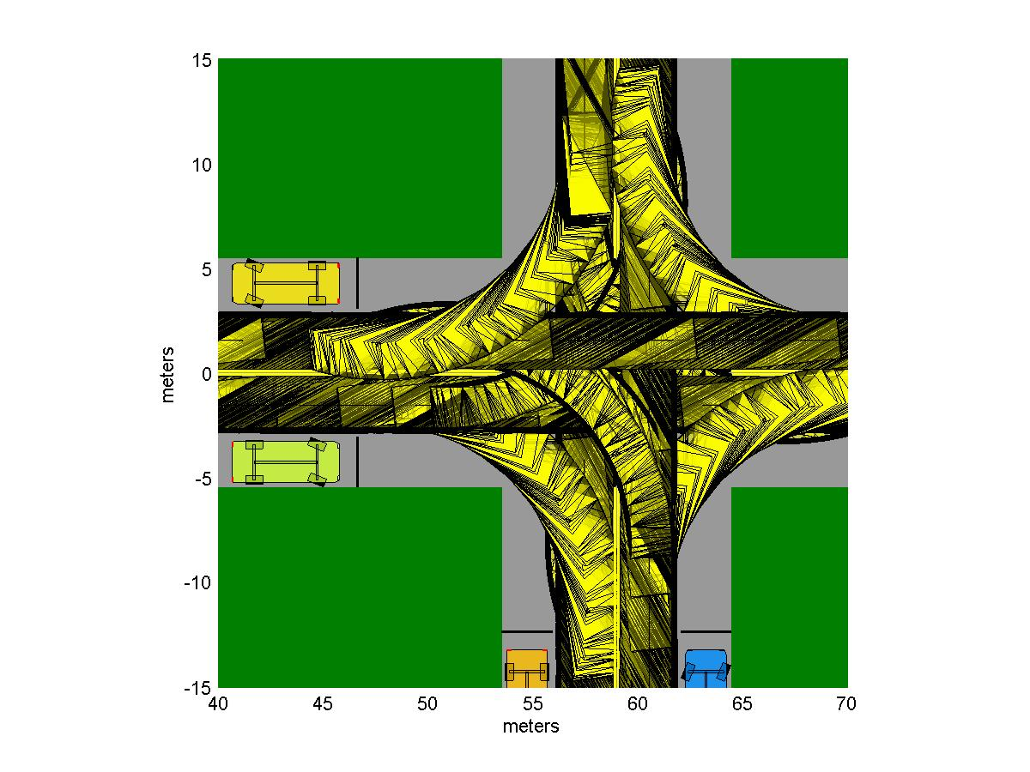
Complex controllers
*Images courtesy of David C. Conner

Slide 37
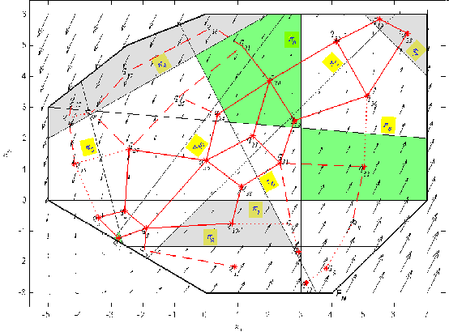
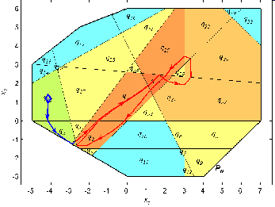
LTLCon: control of linear systems from LTL formulas over linear predicates
Marius Kloetzer Calin Belta

Slide 38

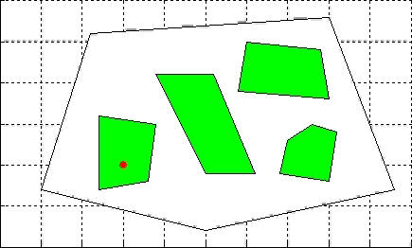
Robust LTL
Georgios E. Fainekos, Antoine Girard, Hadas Kress-Gazit, George J. Pappas. Temporal Logic Motion Planning for Dynamic Robots, Automatica. To appear.

Slide 39
Handling
Multiple Robots

Slide 40
Decentralized
Automaton for each robot
Other robots are a part of the environment
Scales well*
Hard to provide global guarantees
Centralized
One automaton for all robots
Multi robot controllers
Global guarantees
Scales exponentially with the number of robots

Slide 41
Extensions
Multi Robot
  Naturally captured in a decentralized way
  The environment of each robot contains all other robots
  “ If robot 2 is in the kitchen, do not go there”
  X = {Robot2Kitchen,… }, Y = {Kitchen, Hall, Bedroom,… }
  … ∧ []( Robot2Kitchen → ¬O(Kitchen) ) ∧…

Slide 42
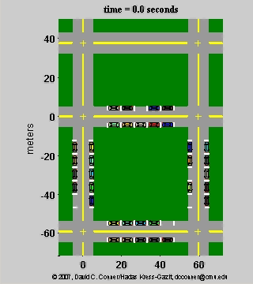
Extensions
Multi Robot
“Drive around the environment, while obeying traffic rules, until you find a free parking space, and then park”
“Leave the block, while obeying traffic rules, through Exit_{i}”

Slide 43
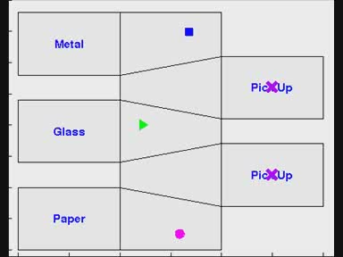
Multi Robot - Centralized
“Pick up items and sort them according to the material they are made of”

Slide 44
Incorporating
“Nemo may be in one of rooms 1, 3, 5 and 8.
Starting in corridor 12, look for him in these rooms.
If at some point you see him, stop and beep”
Language

Slide 45
Constructing φ
“Nemo may be in one of rooms 1, 3, 5 and 8.
Starting in corridor 12, look for him in these rooms.
If at some point you see him, stop and beep”
Structured English
(MURI
SUBTLE)
H. Kress-Gazit, G. E. Fainekos and G. J. Pappas. Translating structured English to robot controllers. Advanced Robotics Special Issue on Selected Papers from IROS 2007. To appear.

Slide 46
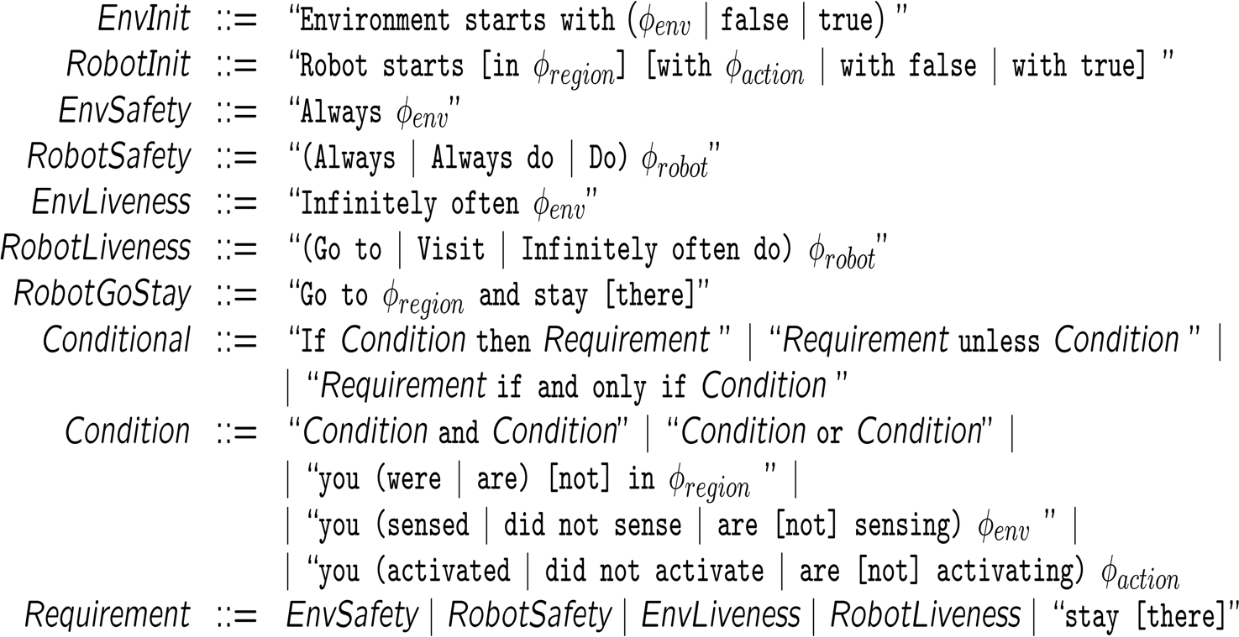
Structured English Interface

Slide 47
Structured English Interface
“Nemo may be in one of rooms 1, 3, 5 and 8.
Starting in corridor 12, look for him in these rooms.
If at some point you see him, stop and beep”
Environment starts with not Nemo
…
You start in r12
If you are sensing Nemo then stay there
Beep if and only if you are sensing Nemo
If you are not sensing Nemo then go to r1
…

Slide 48
Case studies

Slide 49
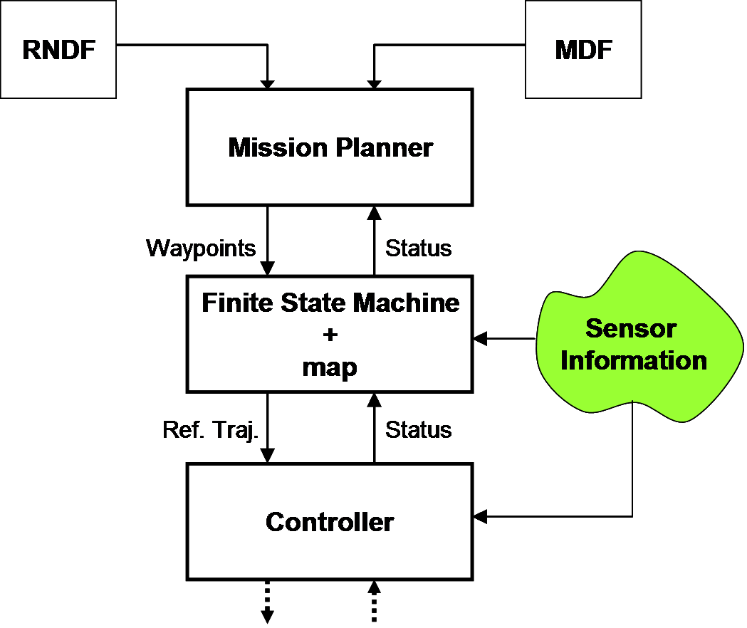
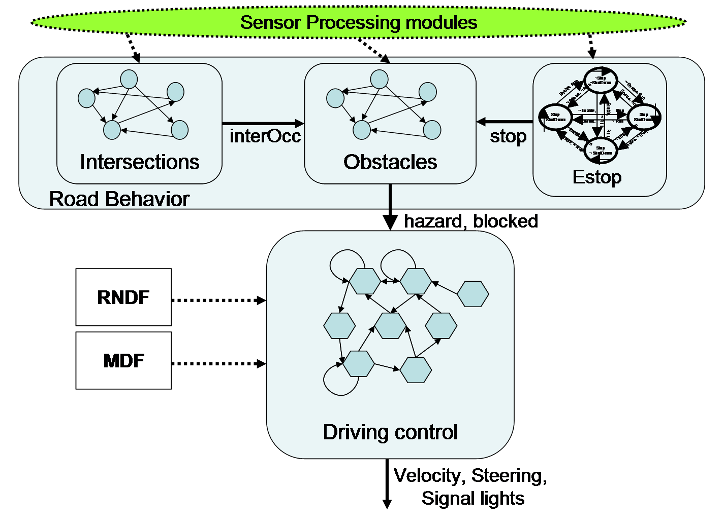
DARPA’s Urban Challenge
“Reach sequence of checkpoints while observing traffic laws”
Inputs: Obstacle, leftOcc, leftMoved, Estop, timerUp,…

Slide 50
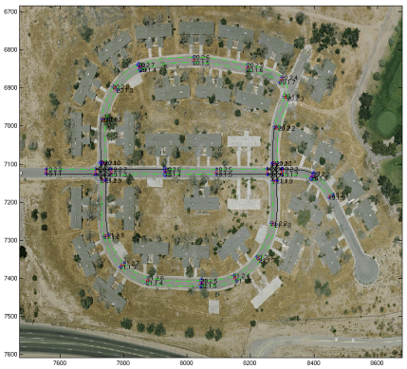
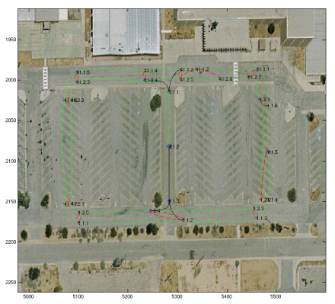
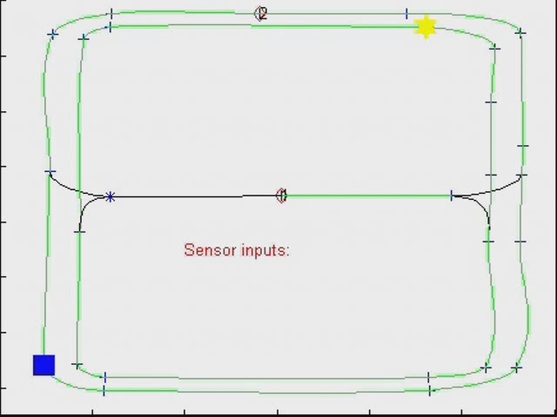
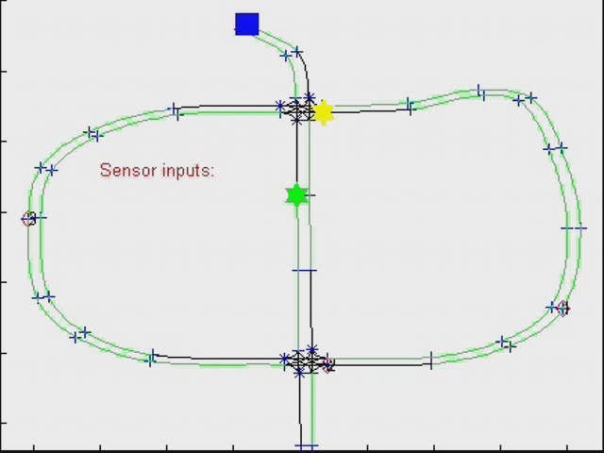
DARPA’s Urban Challenge - NQE
Robot moving
Robot stopping
Other vehicles
Obstacles

Slide 51
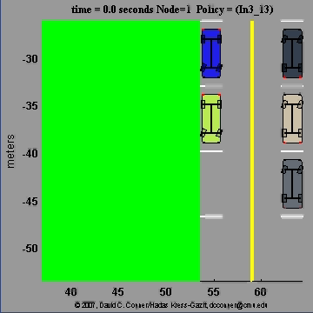
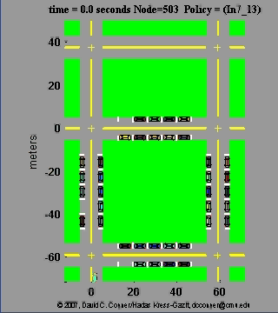
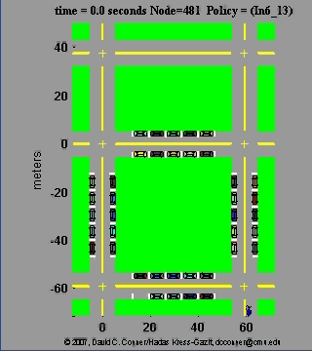
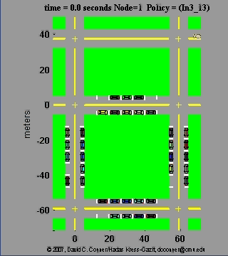
Valet parking

Slide 52
Summary
Synthesis
Holy grail: Natural language specifications to “correct by construction” controllers
  Natural language to temporal logic formula that captures specification, environment assumptions and allowed automaton transitions
  Synthesize finite state automaton satisfying specs
  Local hybrid controllers for achieving transitions
Generalizations to
  More complex dynamics
  Multi-robot models
  Robust specifications

